Slide 1
Labor market Discrimination
Labor Market Disparities by Gender and Race
Econ 3100-090
Catherine Ruetschlin, PhD
Source: Ehrenberg & Smith, Chapter 12

Slide 2
Labor Market Discrimination
Labor market discrimination: workers with identical productive characteristics are treated differently due to demographic identity
Pre-market differences: differences in productive capabilities
May be the result of pre-market discrimination or individual choices
Not considered labor market discrimination
Both labor market discrimination and pre-market differences are sources of unequal outcomes
Two measured types of discrimination are
Wage discrimination: paying equally productive workers different wages for the same work
Occupational discrimination: segregating equally productive workers into different jobs based on perceived demographic characteristics (sometimes called opportunity hoarding)

Slide 3
Occupational Segregation
Occupational Discrimination
With respect to gender, occupational segregation is reflected when there are female-dominated occupations and male-dominated ones.
Discrimination occurs when occupational choices are directly limited or if they are influenced by lower payoffs to given human capital characteristics.
Some gender segregation is the result of pre-market differences or preferences.
Occupational segregation by gender: about 50 percent of workers would have to change jobs to achieve equal representation
Black/White occupational segregation: about 25 percent of workers would have to change jobs to achieve equal representation

Slide 4
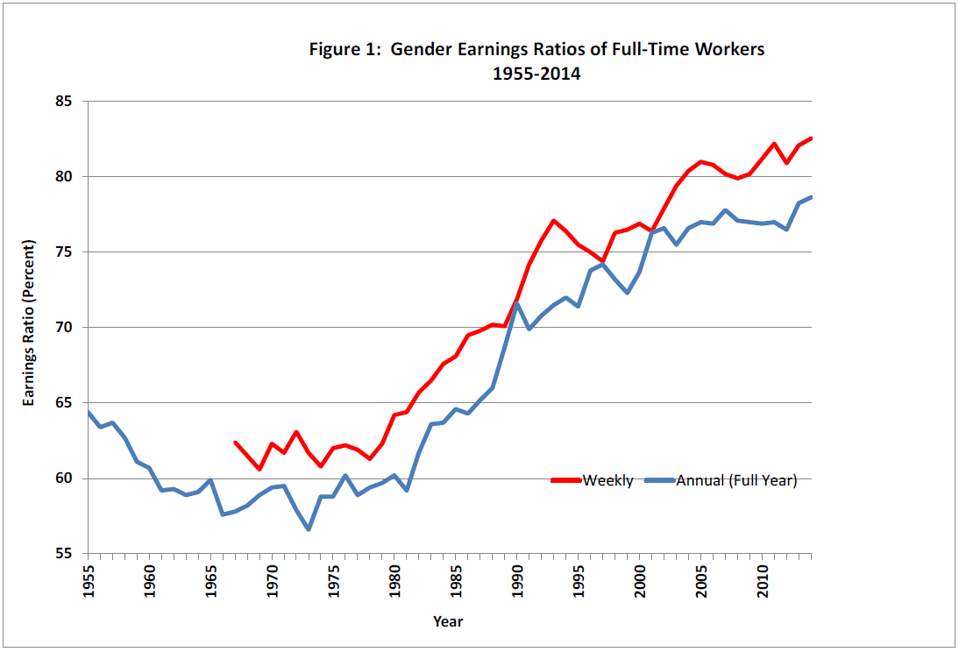
Gender Wage Gap, 1955-2014 Francine Blau and Lawrence Kahn, “The Gender Wage Gap: Extent, Trends, and Explanations” NBER Working Paper #21913, January 2016
The gender wage gap is the ratio of female earnings to male earnings
In 2014 earnings of full-time working women were 79 to 83 percent of those of men, compared to about 60 percent in 1980.
Women’s relative wage began to rise sharply in the 1980s with a slower rise thereafter
The gender pay gap closed more substantially at bottom (10th percentile) and middle (50th percentile) than the top (90th percentile)

Slide 5
Explaining the gender wage gap
Explanations of the wage gap are tested by measuring two broad components of the gap
Differences in group characteristics that lead to wage differentials
The “explained” portion
Differences in the return (wage paid) to individuals with identical characteristics
The “unexplained” portion
May be due to labor market discrimination or unobserved productivity characteristics
If differences in group characteristics such as education, experience, and occupation are caused by discrimination, the model may understate the effects of discrimination.

Slide 6
Explanatory Variables: Gender Wage Gap
Education
Cannot explain any portion of the gender wage gap today
Women are more likely than men to have a BA or more education today
Experience
Contributes about 14 percent of the gap in 2014
In 1981, men had nearly 7 more years of full-time labor market experience on average than women. By 2011, the gap was only 1.4 years
Occupation and Industry
Contributes 51 percent of the gap in 2014
Despite increasing female representation in higher-paid, traditionally-male professions
Union Coverage
Cannot explain any portion of the gender wage gap today
Decreasing union coverage since the 1980s disproportionately among men
Unexplained factors contribute 38 percent of the gender wage gap

Slide 7
Experimental Studies of Gender Discrimination
Orchestrating Impartiality: The Impact of ‘Blind’ Auditions on Female Musicians
Goldin and Rouse study the effect of instituting ‘blind’ auditions on female representation in orchestras.
Anonymous auditions raised female representation by 8 percentage points
Sex Discrimination in Restaurant Hiring: an Audit Study (David Neumark, 1996)
Similar resumes with randomly assigned male and female names sent to Philadelphia restaurants
High-end restaurants significantly less likely to hire women
Female’s resumes 40 percent less likely to get an interview
Female interviewees 50 percent less like to get a job offer

Slide 8
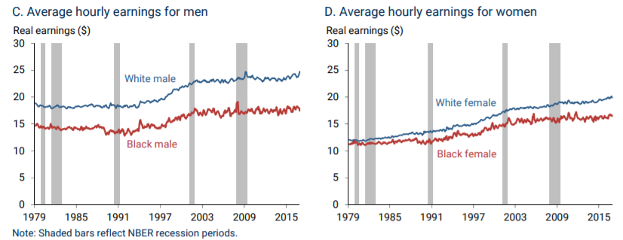
The Black/White Wage Gap, 1979 to 2016 source: Federal Reserve Bank of San Francisco, “Disappointing Facts About the Black-White Wage Gap,” September 5, 2017
The Black/White Wage Gap has grown over time for both men and women
The relative wage for Black/White men was 80 percent in 1979 and declined to 70 percent by 2016
The relative wage for Black/White women was 95 percent in 1979 and declined to 82 percent by 2016
The Black/White wage gap is observable at all education levels
Among men, the earnings gap is larger among workers with a BA than among those with only high school
Among men and women, the earnings gaps have been growing for workers at all levels of educational attainment

Slide 9
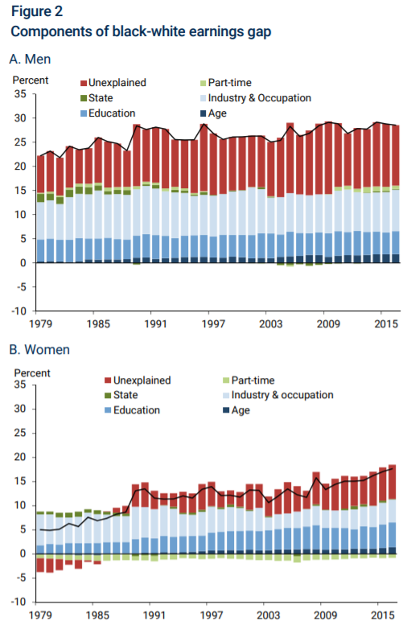
Explaining the Black/White Wage Gap source: Federal Reserve Bank of San Francisco, “Disappointing Facts About the Black-White Wage Gap,” September 5, 2017
Unexplained factors contribute 43 percent of men’s gap.
Growth in the contribution of unexplained factors is the source of almost all of the growth over time.
Occupation and Industry contribute 30 percent of the male wage gap and 28 percent for women.
Educational attainment explains 17 percent of the male wage differential and 28 percent of the female differential.

Slide 10
Black/White Employment Gap Source: Bureau of Labor Statistics Current Population Survey
For both men and women, the unemployment rate among Black workers is approximately twice that among whites.
Black workers suffer disproportionately in a recession despite the apparent constancy of the black/white ratio of unemployment rates.
Black employment-population ratio is lower due to unemployment rates and labor force participation ratios.
Black women have had higher LFPR than white women since 1970.
Black men have had consistently lower LFPR than white men.

Slide 11
“Are Emily and Greg More Employable than Lakisha and Jamal?” Marianne Bertrand and Sendhil Mullainathan, AMERICAN ECONOMIC REVIEW, Vol. 94, NO. 4, SEPTEMBER 2004
Field experiments in labor markets reveal that discrimination is still prevalent across industries and occupations.
Bertrand and Sendhil send fictitious résumés to job ads, distinguished by ‘white-sounding’ and ‘Black-sounding’ names in 2000 and 2001.
White names receive 50 percent more callbacks for interviews.
The gap in callbacks widens as resume quality improves.
Discrimination in a Low-Wage Labor Market: A Field Experiment, Pager, Western, and Bonikowski (2009)
Black, white, and Latino job applicants matched by demographics, résumés, and interpersonal skills apply for entry-level jobs in 2004
Black applicants were half as likely as equally qualified whites to receive a callback or job offer.
Black and Latino applicants with clean backgrounds fared no better than white applicants just released from prison.

Slide 12
Labor market Discrimination
Labor Market Disparities by Gender and Race
Econ 3100-090
Catherine Ruetschlin, PhD
Source: Ehrenberg & Smith, Chapter 12

